Slide 1
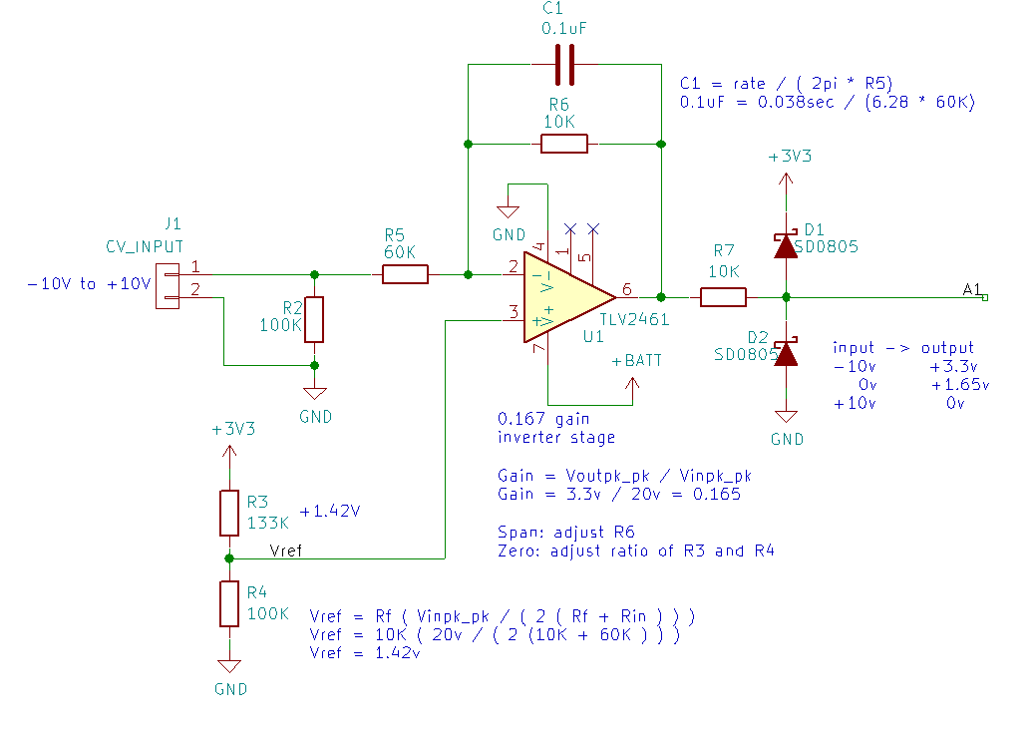
+10v
+3.3v
CV input
0v
output
to DAC
+1.65
-10v
0v

